Slide 1
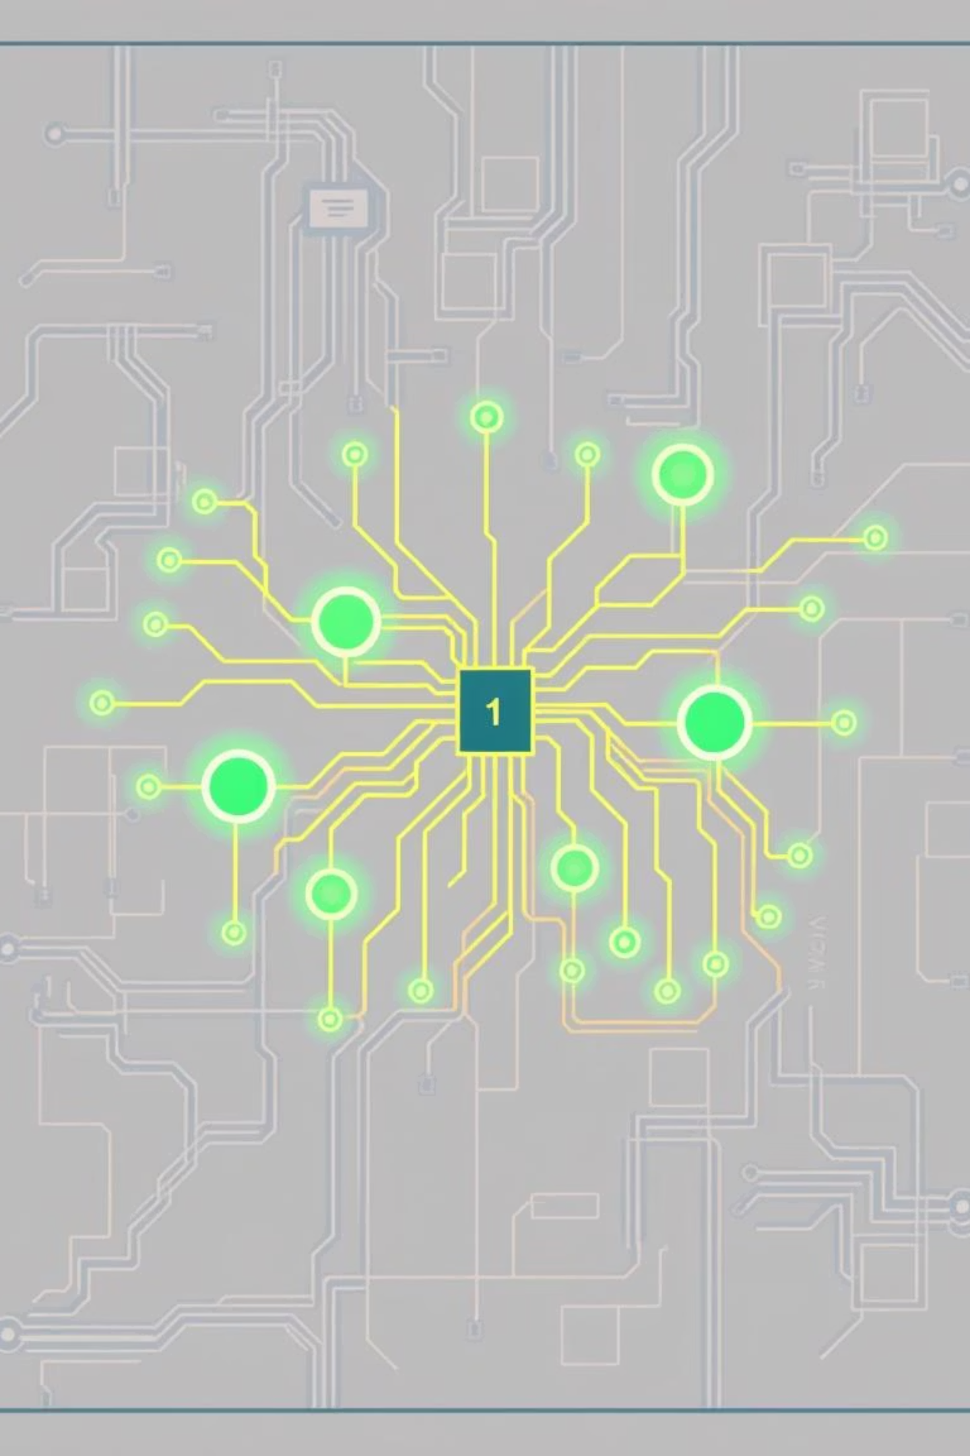
Integrated Science: Symbols Used in Circuit Diagrams
A visual guide to understanding and drawing electrical circuit symbols

Slide 2
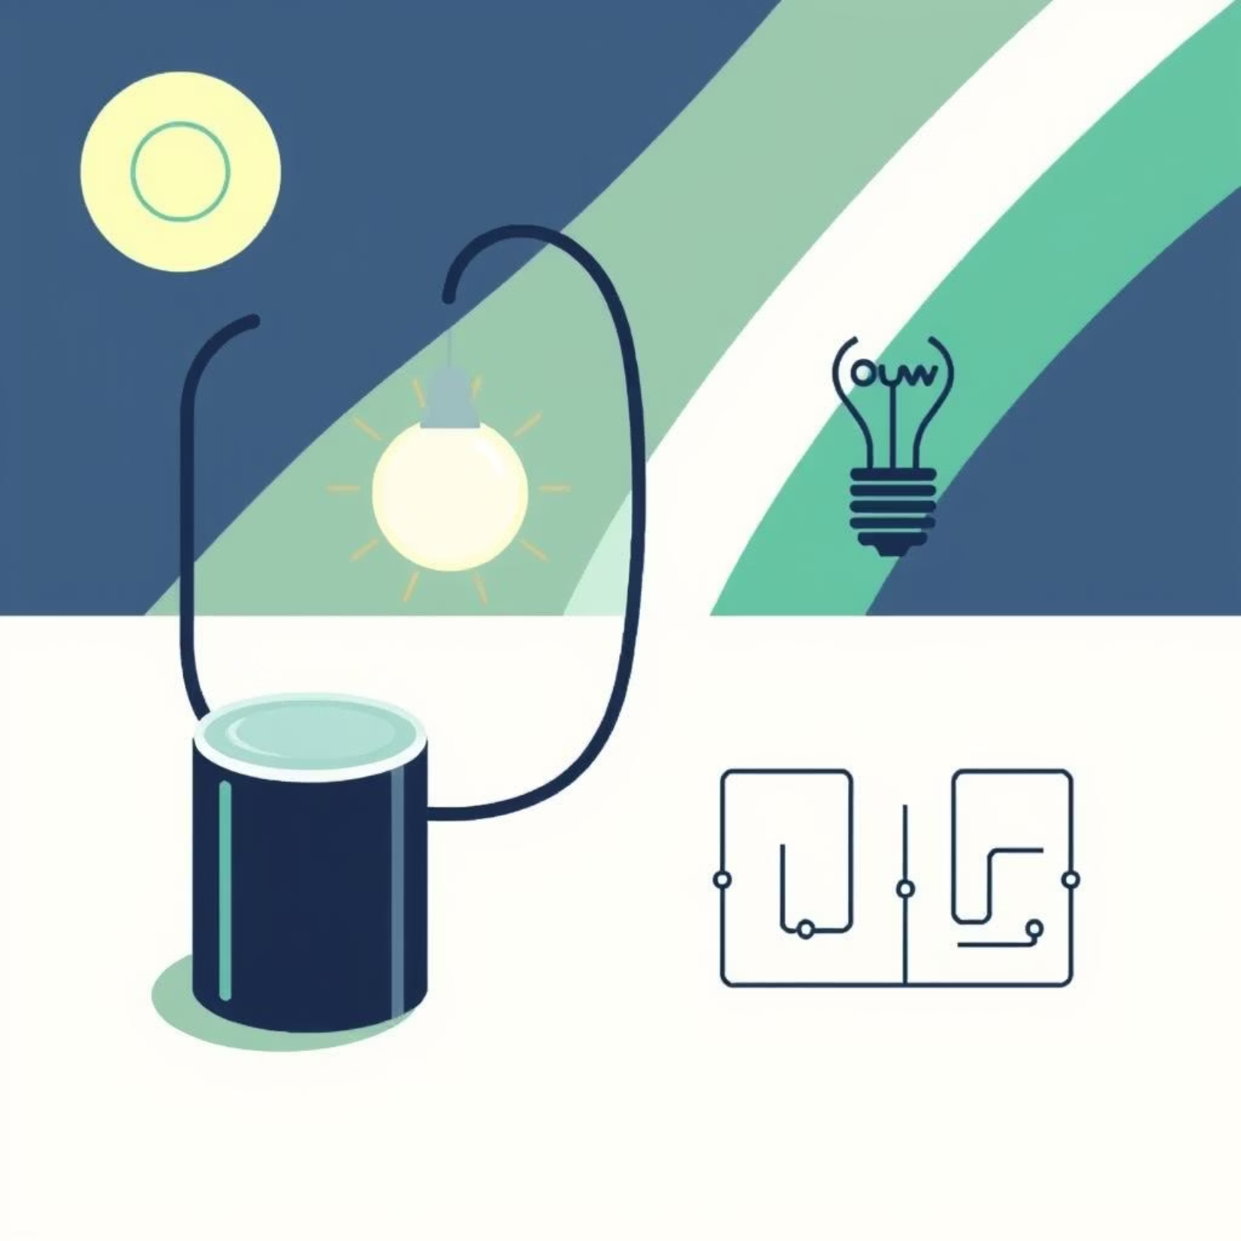
What is a Circuit Diagram?
A circuit diagram is a simple drawing that shows how electrical parts are connected in a circuit. It uses symbols instead of real pictures of the components, making it easy to understand and draw.

Slide 3

Why We Use Symbols
Simplicity
Functionality
Symbols are smaller and simpler than real pictures of components
They help us know what each component does in a circuit
Practicality
Makes it easier to design and build circuits

Slide 4
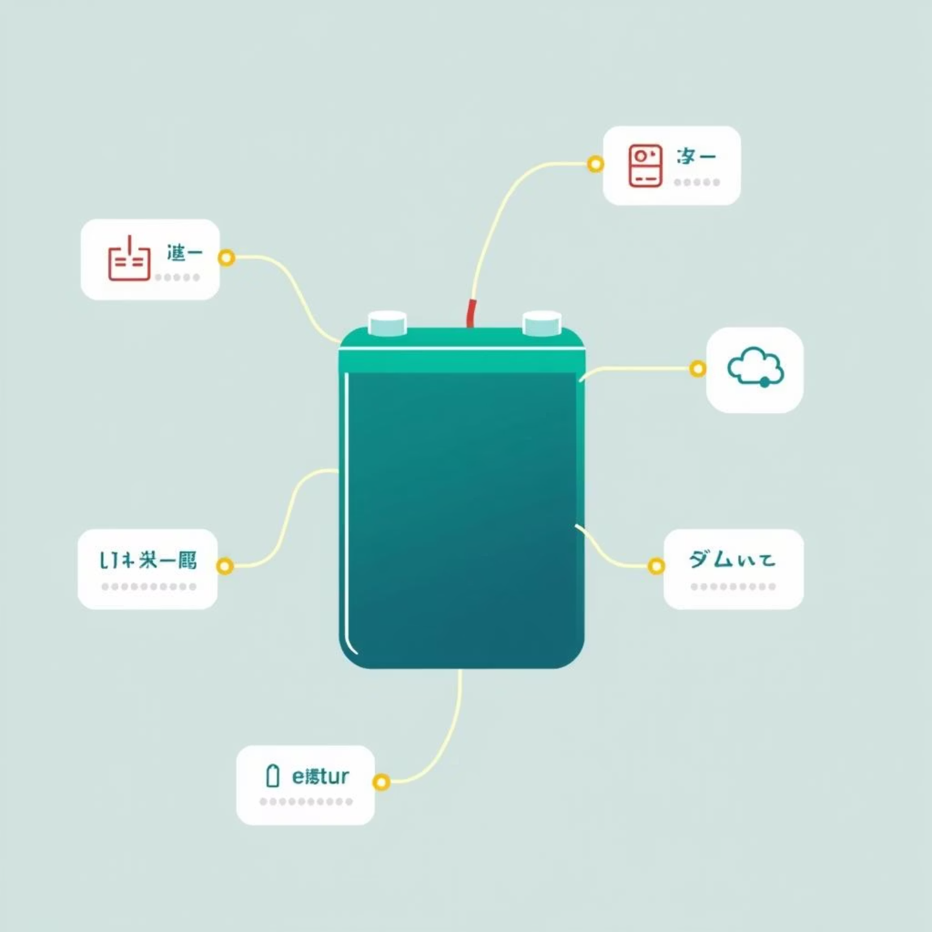
Power Sources and Conductors
Component
Symbol
Function
Battery/Cell
—|— or —||—
Supplies electricity
Wire/Conductor
Straight line —
Connects components

Slide 5
Light and Control Components
Component
Symbol
Function
Example/Use
Bulb/Lamp
Circle with cross ⊗
Produces light
Torch bulb, street lamp
Switch
—o— (open) / —●— (closed)
Turns circuit ON/OFF
Light switch at home
LED
Triangle pointing to line with arrows ▶
Lights up, one-way current
Indicator lights

Slide 6
Common Electrical Components and Their Symbols
Component | Function | Example/Use
Battery / Cell | Provides power | Phones, remote, etc
Bulb / Lamp | Produces light | Torch bulb, street lamp
Switch | Turns the circuit ON or OFF | Light switch at home
Resistor | Slows down the flow of electricity | Controls brightness of bulbs
Wire / Conductor | Connects components | Copper wires connecting battery to bulb
Motor | Produces movement | Fan, toy car motor
Ammeter | Measures current | Used in lab experiments
Voltmeter | Measures voltage | Checks battery voltage
LED | Light Emitting Diode- Lighting/Illumination | Lights up, allows current one way

Slide 7
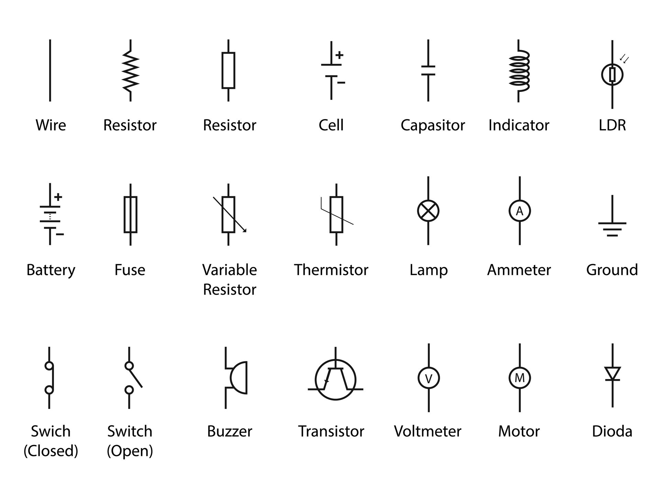
SYMBOLS
Capacitor
Diode

Slide 8

Resistors and Motors
1
Resistor
Symbol: Zig-zag line /\/\/\
Function: Slows down the flow of electricity
Use: Controls brightness of bulbs
2
Motor
Symbol: Circle with M inside
Function: Produces movement
Use: Fan, toy car motor

Slide 9
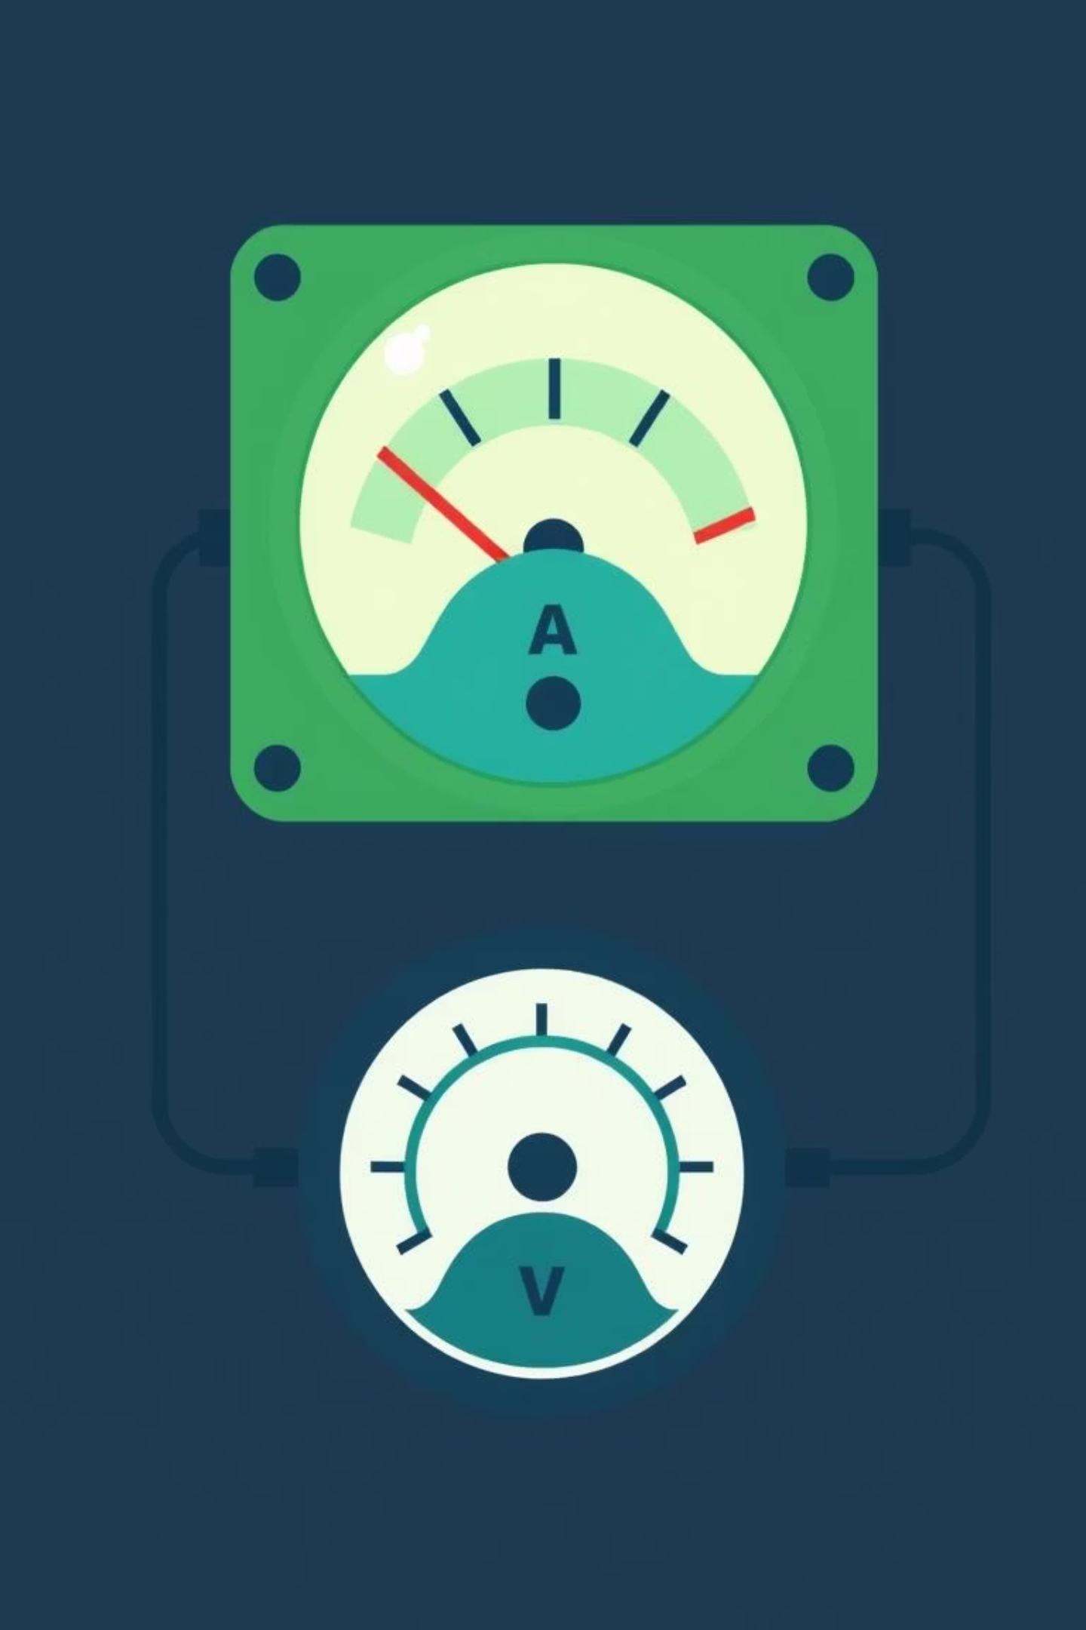
Measurement Devices
Ammeter
Voltmeter
• Symbol: Circle with A inside
• Symbol: Circle with V inside
• Function: Measures current
• Function: Measures voltage
• Use: Laboratory experiments to measure the flow of electricity
• Use: Checking battery voltage and potential difference

Slide 10
Basic Rules When Drawing Circuit Diagrams
1
Use correct symbols for components
2
Connect wires with straight lines
Wires should be drawn as straight lines with right-angle turns when needed
Each component has a standardized symbol that should be used consistently
3
Follow the flow of electricity
4
Show switch position correctly
Don't draw components randomly—follow the path from battery to devices
Draw the switch open or closed depending on whether the circuit is ON or OFF

Slide 11

Example of a Simple Circuit
Components:
1 battery
1 bulb
1 switch
Connecting wires
Description: Battery supplies electricity → current flows through wires → switch controls flow → bulb lights up

Slide 12

Teaching Ideas & Summary
Summary
Circuit diagrams use symbols to show electrical components
Symbols make circuits easy to draw and understand
Common components include battery, bulb, switch, resistor, motor, ammeter, voltmeter, LED
Always follow flow of current and correct symbol rules when drawing
Teaching Ideas
Give students real components and ask them to draw the symbols
Let pupils draw a simple circuit to light a bulb
Play a matching game: match components with their symbols

